Slide 1
ME 170 Lab 2
Synthesis Space

Slide 2
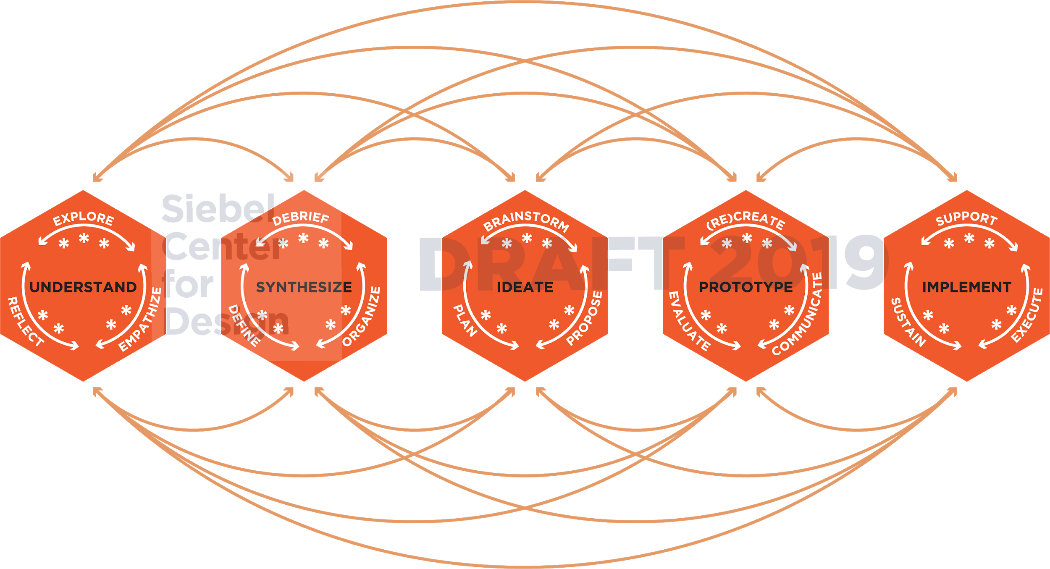
Notes:
During the UNDERSTAND space, designers will
Explore
Establish a common problem space
Review current landscape or context
Document their biases and predictions
Empathize
Interview
Observations
Immersive Observations (location, community, context)
Locate resources
Identify extreme users
Reflect
Reflect on their biases
Reflect on the projects’ motivations
Reflect on stakeholders’ needs

Slide 3
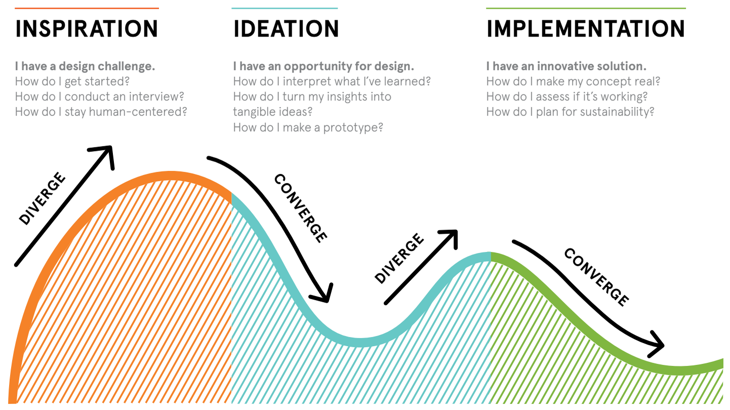

Slide 4
Learning Objectives
After this lab you should be able to...
Communicate important observations and findings using storytelling
Discover research areas where more information is needed
Define “insights” and identify them in your project context

Slide 5
Observation
Empathy
Notes:
Lucas

Slide 6
What is Synthesis?
Act of making sense of what we’ve seen and heard during observations to come to a shared understanding
Takes us from inspiration to ideas, from stories to solutions
Enables us to establish a new perspective and identify new opportunities

Slide 7
Steps of Synthesis
Downloading interviews and observations
Identifying patterns and themes
Extracting key insights
Create frameworks to visually communicate insights
Not covered in ME 170, but useful for sharing complicated insights quickly

Slide 8
Tell stories about individuals
Take turns telling stories
Actively listen to your team members and look for meaning
Analyze and interpret meaning
Focus on the highlights
Go deeper
Notes:
Ava

Slide 9
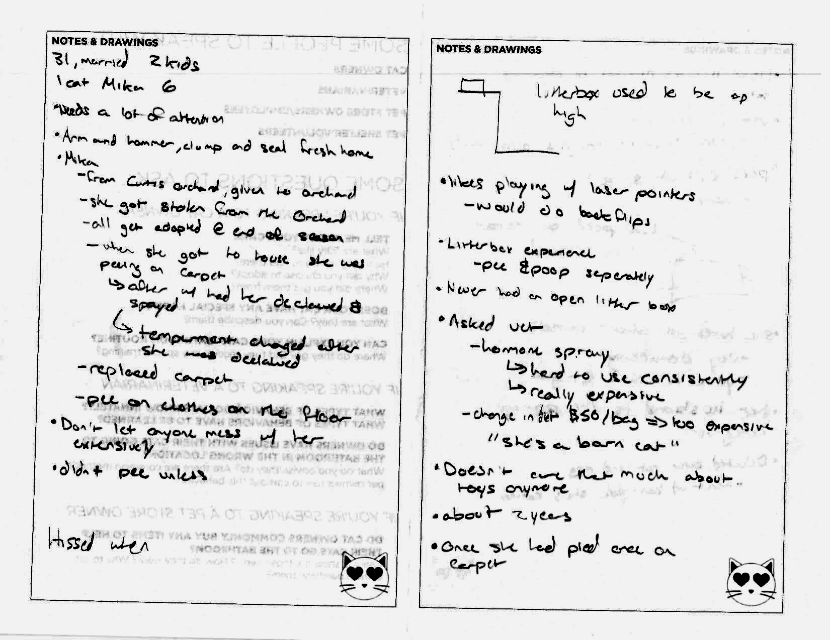
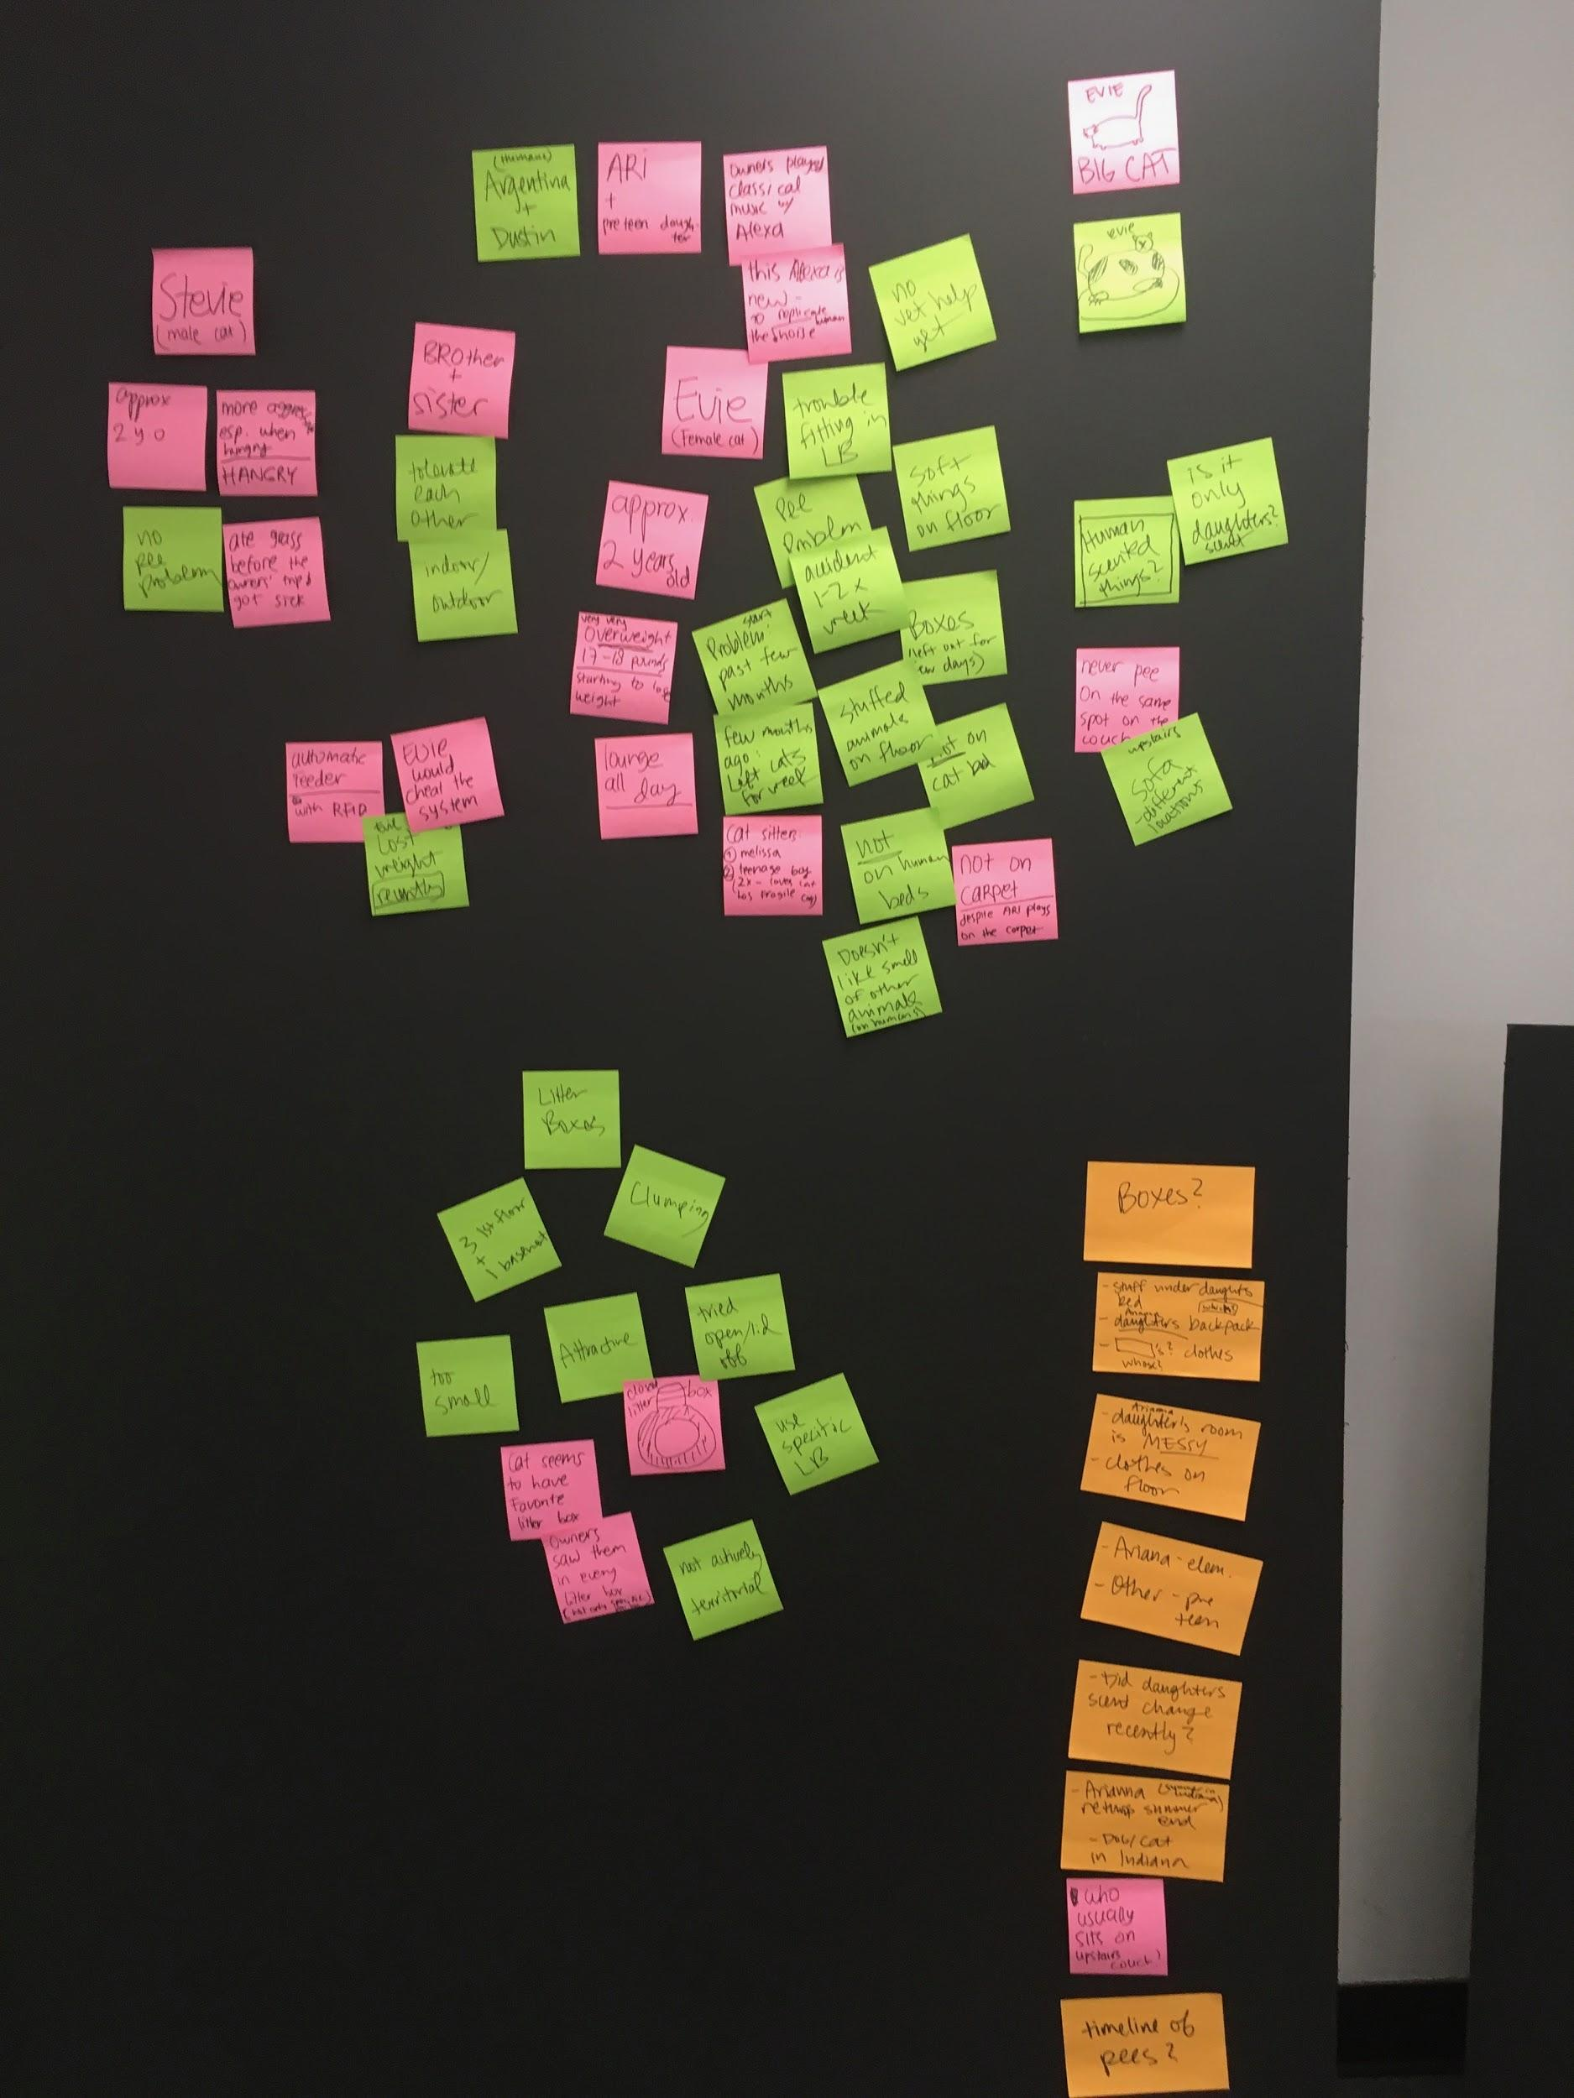
Notes:
Ava

Slide 10
Work with your class to download interviews & observations
(up to 30 minutes)
Name
3-5 bullets of biographical information
quote/
observation #1
quote/
observation #2
quote/
observation #3
quote/
observation #4

Slide 11
Steps of Synthesis
Downloading interviews and observations
Identifying patterns and themes
Extracting key insights
Create frameworks to visually communicate insights

Slide 12
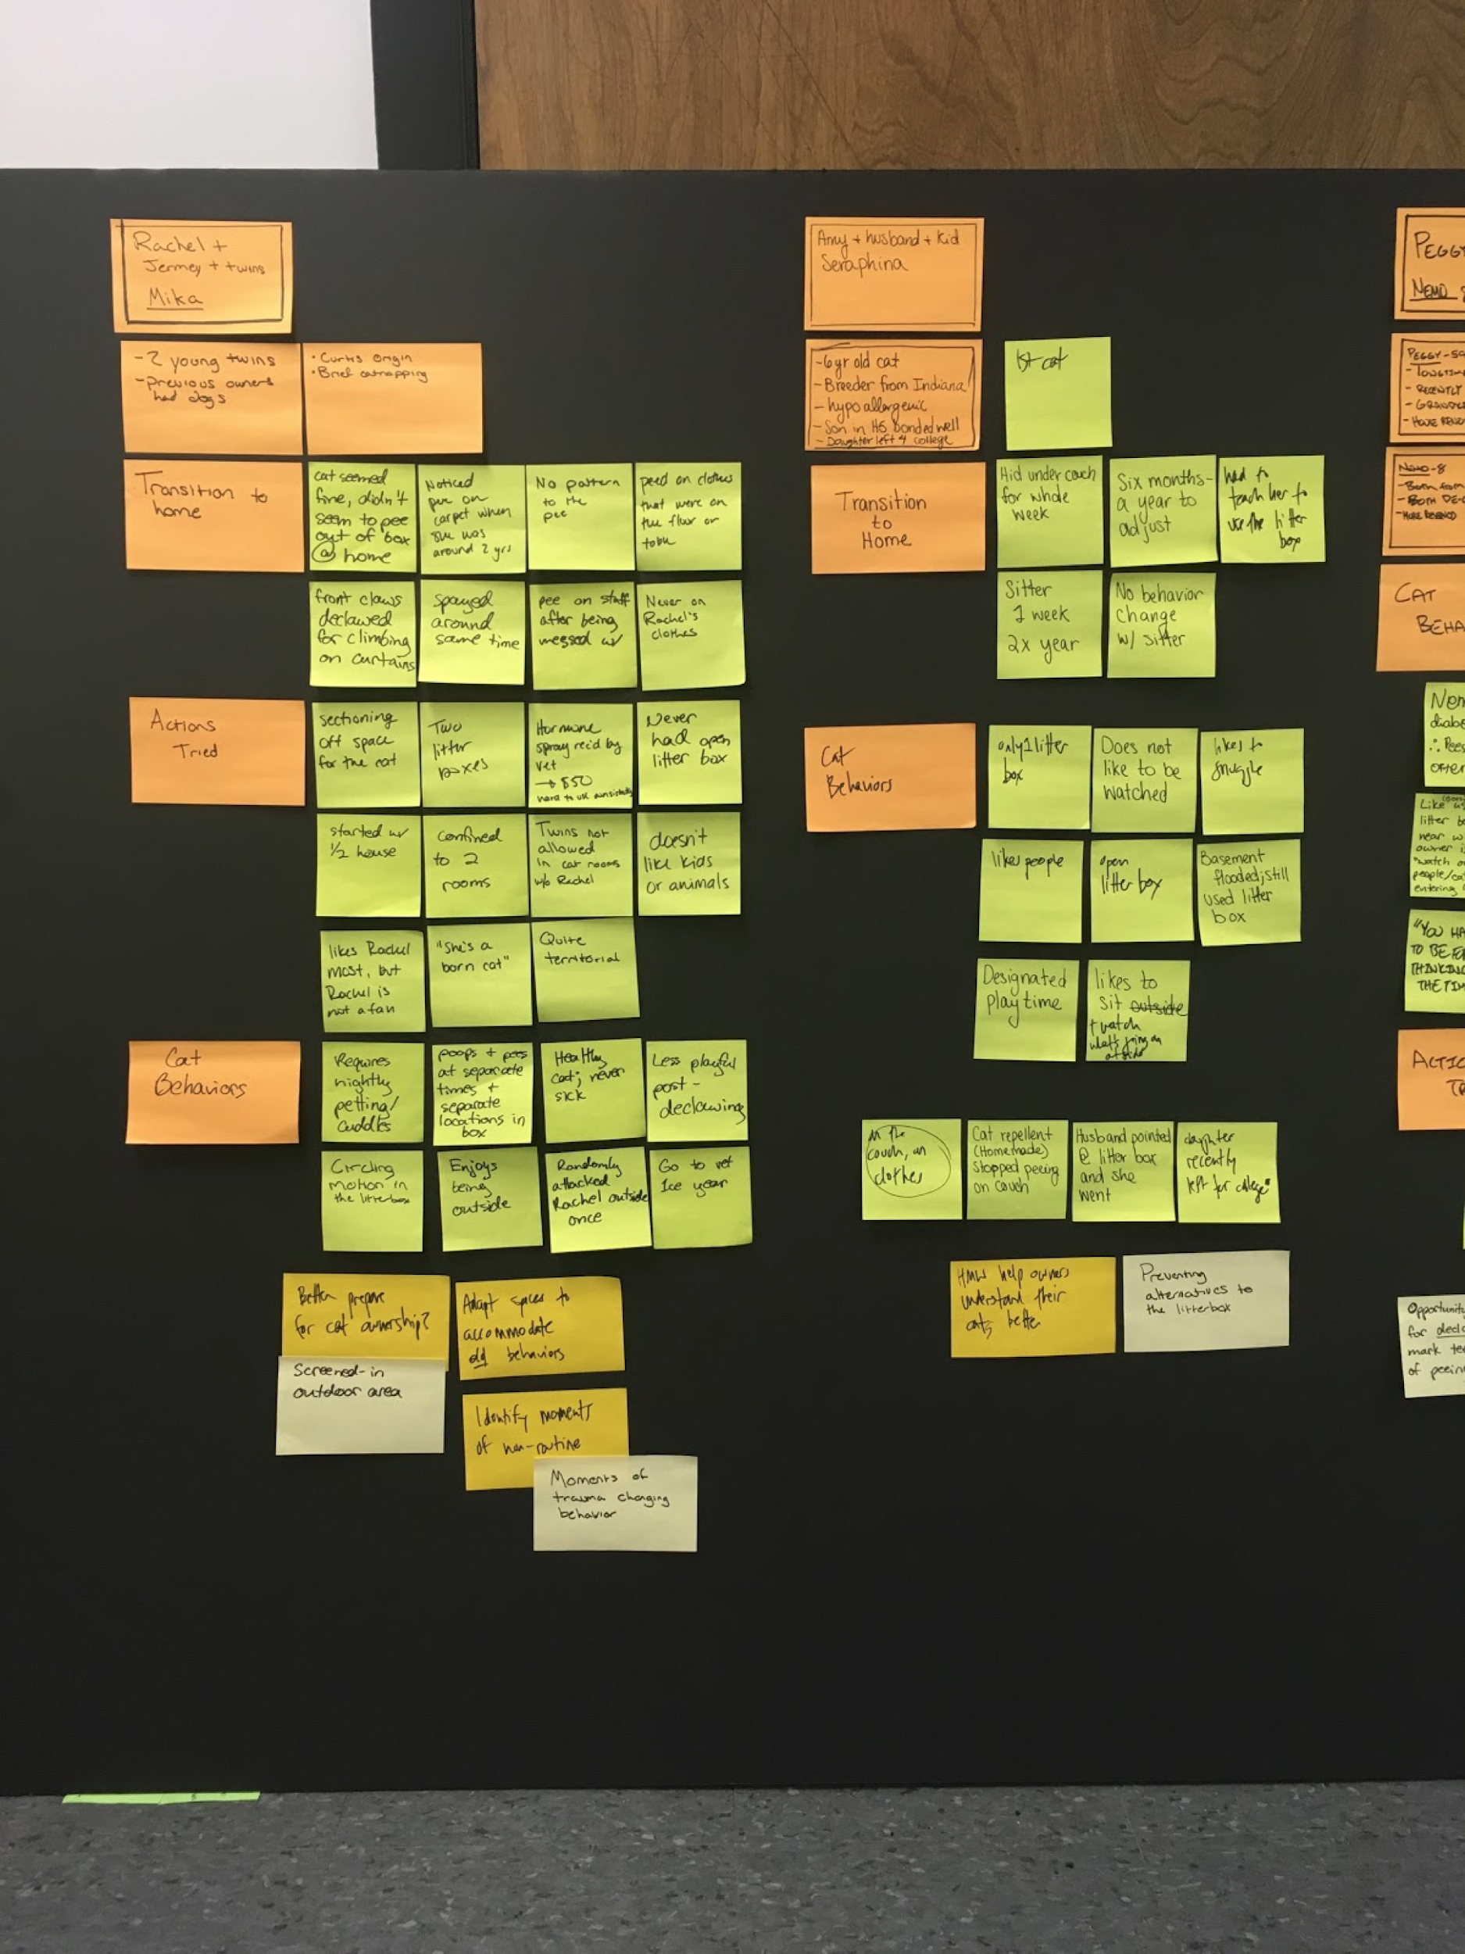
Identify patterns and themes
Look for buckets/groups/themes
Consider the relationships between these
Group and re-group
POINT
Problems, Opportunities, Insights, Needs, Themes
Notes:
Lucas

Slide 13
Now it’s your turn
Work with your team to Identify Patterns and Themes
(10 minutes)

Slide 14
Steps of Synthesis
Downloading interviews and observations
Identifying patterns and themes
Extracting key insights
Create frameworks to visually communicate insights

Slide 15
Extracting Key Insights
An insight should be a full sentence that takes a stance on a particular topic.
Insights are revelations - the unexpected things that make you sit up and pay attention
Insights bring visibility and clarity to previously hidden meaning
Insights allow us to see the world in a new way

Slide 16
Patterns & Themes into Insights
Pattern/Theme
Insight
Dining halls have diverse options
Offering many diverse meal options may only be desirable at certain times or locations.
Students want consistency and familiarity

Slide 17
Now it’s your turn
Work with your team to Extract Key Insights
(10 minutes)

Slide 19
Capture your understanding
Frame your current understanding of the problem using a “Point of view” statement.
“ User needs unmet need because surprising insight ”
Instructions
Work with your team (5 mins):
Write a POV statement
Confirm it with your TA
Submit to: https://forms.gle/BwhsuPGATQ6vhpc37
Notes:
This is your first, informed guess. Your understanding of the design challenge, potential unmet needs and opportunity areas will change as you continue through HCD.

Slide 20
What else do you need to know?
It’s very likely that you have unanswered questions! You should consider what additional information is still needed and how your team plans to get it.

Slide 21
ME 170
Ideate Space

Slide 22
Notes:
During the IDEATE space, students will learn to…
Brainstorm
Set goals for the ideation session
Defer judgement
Ideate of potential solutions
Plan (new to term to reflect reordering)
Break down the problem into manageable pieces
Whittling down the ideas from brainstorming to proposing
Develop a plan of action
Propose
Communicate proposed solutions
Iterate in response to new information
Come up with alternative solutions

Slide 23
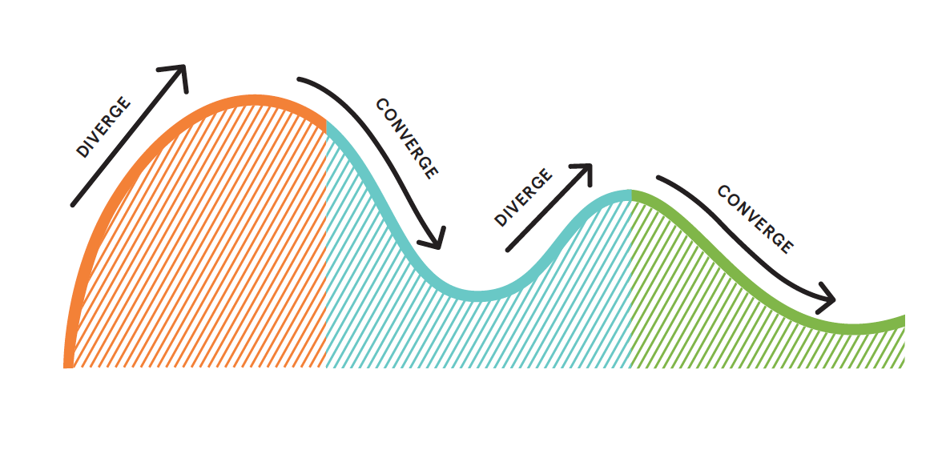
Explore the problem
area
Establish a common problem space
Define the unmet need
Ideate potential solutions
Develop, refine and iterate
*Example does not represent all cases

Slide 24
SYNTHESIS
POV

Slide 25
Learning Objectives
After this lab you should be able to…
Write “point of view” statements to describe the project scope and motivate action
Formulate “how might we” questions to guide project ideation
Develop a plan to complete the project using human-centered design

Slide 26
Opportunity Areas and Ideation

Slide 27
Defining Opportunity Areas
Not solution oriented
Narrowing in on a specific moment or need
This is an art not a science!
It’s best to start somewhere and iterate

Slide 28
“How might we…” Questions
“How might we…” suggests that a solution is possible
Offers you the chance to answer them in a variety of ways
A properly framed How Might We doesn’t suggest a particular solution, but gives you the perfect frame for innovative thinking
Useful at various points in the process, but should be carefully phrased to provide the correct scope

Slide 29
Creating Design Opportunities
Example Challenge: improving efficiency of dining halls
Potential HMWs:
“HMW make dining halls more efficient?”
Too broad
“HMW create a dishwasher which cleans forks faster?”
Too narrow
“HMW make the downtime while waiting for food more useful?”
Just right!
This is where we started
This is solution-oriented
This will prepare us for ideation

Slide 30
Creating Design Opportunities
Example Challenge: re-designing accessible transportation
Potential HMWs:
“HMW improve travel efficiency for wheelchair users?”
Too broad
“HMW design an app to find accessible drop-off points for Ubers at an airport”
Too narrow
“HMW coordinate transitions between Uber riding and airport entrance”
Just right!

Slide 31
Come up with at least 5 HMWs (5 per person).
Then discuss with your team. [10 mins]
How might we…?

Slide 32
Choose 1 HMW each (4 per team)
Write it down on a post-it
Rotate
Sketch 3 concepts in response to this HMW [5 mins]
Rotate and repeat until finished
Ideation session
Modified 6-3-5 method
A team of 4 should have at least 12 sketches per HMW.
4 x 12 = 48 total concept sketches!
Notes:
Have each team share their HMW question with the class

Slide 33
Ratings come from testing with users or predefined quantitative test metrics
These are your observations and insights! +Engineering Constraints
The importance (weight) of each requirement is informed by our empathetic understanding

Slide 34
Document your work:
-5 slides
-Tell us the story of how you got to now. Who are the main characters? What’s the problem they are facing?
Required info:
Initial interviews - Who? Why? Key findings?
Follow up interview(s) - Who? Why? Key findings?
Point of view Statement
”How might we…” questions
5 different concept sketches - Explain how these concepts address the unmet need.
Notes:
-Initial interviews - Who? Why? Key findings?
-Follow up interview(s) - Who? Why? Key findings?
-Point of view Statement
-”How might we…” questions (include all 4 from ideation in your slides, only talk about the most useful one or two)
-5 different concepts - Explain how these concepts address the unmet need. (remember you will be developing a physical product. The concept can include a larger process or system, but you should be able to identify the physical product you would develop)
-What

Slide 35
Ideate and planning

Slide 36
EXAMPLE Story arc
Resolution
Rising action
Exposition
Interviews
POV
HMW
Concepts
Concepts
Notes:
Students should consider the narrative arc or ‘story arc’ of their presentation! Remember that the problem is still unresolved! This creates unresolved tension and keeps the story compelling (just another reason to stay need-oriented)

Slide 37
Feedback
https://forms.gle/qvemScz1nXnpik836

